Slide 1
Effective communications for union reps
Notes:
Tutor to ensure you have joined online meeting slightly earlier than the start time;
The PowerPoint is not used at the beginning of the session.
You may need to help people with technical issues such as sound Invite people, as they arrive online, to skim through introductory section of workbook (History of Prospect/ Trade Union Terminology) and check they received it ok
Run through the zoom basics – microphone – mute etc, video – off if necessary, reactions when showing the power point, chat box for anything private or sharing, change name function, raise hand function. Polls
Add if zooms/TEAMS crashes or issues with connectivity, tutor will join asap – please ask delegates to work on the activity, look at next activity.

Slide 2
Learning Outcomes
What makes a good communicator?
Variety of union communication roles and their purpose?
Exploring communications tools available and channels available and how to use them
Health check and planning next steps
Notes:
As per the slide and on page 4 of workbook.

Slide 3
Session 1
Activity A
Introductions
Notes:
10.15 – 10.25
Page 12/13 in workbook
Pronoun to be mentioned and refer if necessary, page 10 about letting people speak
Go through Learning outcomes on page 4
Interactive course and reps are encouraged to discuss, raise items and participate in the sessions whether it be online or classroom.

Slide 4
Session 2
Activity B
Health Check
Notes:
10.20 – 10.35
Page 14 in workbook
Before we can establish how effective Communications may work, we need to acknowledge how they are currently working. We’re going to do this by looking at a health check.
Prework – the health check questions given before the course.
Introduce the concept of the health check. To improve we need to know our strengths and weaknesses.
The health check allows us to see and assess how well the communications are currently working (in this instance, in the branch). This can be initially done on a scale of 1-10 (1 being terrible and 10 being fantastic). It is important to be realistic and honest, otherwise real change is unlikely to happen.
You will need to support your chosen number – so if it’s fantastic, what makes you score so high, what do you feel works and have you had feedback to suggest the communication is effective? The same with a terrible score, why?
Also as part of the health check – do you feel you’re reaching the right people – so, members? If not, how could this be improved? Do you feel you have the right form of communications?
Lastly, ideally what would successful communication look like in your branch – how would/could you measure success?
The key point is that comms reps shouldn’t feel like the whole task falls to them – membership of a union is a two-way thing. We’re simply identifying some approaches we they may not have through of previously or perhaps didn’t know how to go about starting.
Some branches/reps may already be using a health check as a guide but this is to explore how to get the most out of the exercise and ensure reps have something to take back to branch with them.
ACTION Complete the action plan and communication branch strategy

Slide 5
Session 3
How Prospect communications work
Why does it matter what branch you are in?
What communications happen when a new members joins Prospect/Bectu?
Structure & support for branches
Notes:
10.45am
Establish what is useful/not useful to gauge what is the most effective types of communication. Also run through the member journey – additional resource resource.
This outlines what information is sent out to new members and when.
RECAP
The key point is that comms reps shouldn’t feel like the whole task falls to them – membership of a union is a two-way thing. We’re simply identifying some approaches we they may not have through of previously or perhaps didn’t know how to go about starting.
Some branches/reps may already be using a health check as a guide but this is to explore how to get the most out of the exercise and ensure reps have something to take back to branch with them.
ACTION Complete the action plan and communication branch strategy

Slide 6
A branch
President/Chair
Branch
Secretary
Committee
Notes:
Representative committee is to aid every member's voice.
Outcome to be achieved:
How a branch is set up
This diagram shows a branch that is at one site and has members in three different departments.
According to Prospect’s rules, a branch has to have an elected chair, (click 1)
Another role needed under union rules is a secretary (click 2)
A branch meeting is where an issue can be discussed and a democratic decision can be decided and voted on. What the majority at a branch meeting decides is the course of action a representative takes up with management on the members’ behalf.
Most members do not want to attend regular branch meetings, But decisions still need to be made on the day-to-day business of the branch and to facilitate this the branch elects a committee (click 3)
It is very important that all the different working areas/grades/departments are represented on the committee.

Slide 7

What comms are important to a new member?
Who/What is communicating to your new member?
Notes:
Try to remember what it feels like to be a member – what communications are useful, what is too much communication and what things were you frustrated about never receiving information about.
Its important to put ourselves in our members shoes as this will promote a real understanding of how we can effectively communicate with members. However, it isn’t all down to the branch – a member must be engaged in the union as well, it’s important to highlight this when they are looking to join as members get the most from their membership when they use it.
Run through the member journey when they join…..(if not already)

Slide 8
Good Communications are two way
What do you need to know from members?
How can you get this information?
What will be your ‘foghorn message’ to member to get them to engage?
How can members contribute?
Notes:
Decide on your ‘foghorn message’ – the most important thing you want to get across to the member – whether its’ about joining, communicating or during a campaign.
A foghorn message can be context-specific – eg “Our website is out of date”.
Alternatively, it can be a more general attitude or standpoint – eg “We all want is a good place to work”.
Your foghorn message should be repeated at every opportunity – the aim is for it to shape and explore the member/non member expectation and their attitude to the union more generally.

Slide 9
Session 4
Types of Communication Rep
Branch officer roles – Secretary/convenor/president
Membership and recruitment secretary
Communication rep
Ebranch administrator
Comms administrator
Notes:
Its important to denote the difference in permissions especially for those in the branch wishing to use the ebranch system. (Prospect Dec 24 – June 2025?) TBC) Bectu predominately using the new movement tool
E-branch -Branch officer roles and the membership and recruitment secretary have full access, so they can access the membership list/new joiners/leavers, add posts, send bulk emails and write up/add to the homepage to engage their members.
Communication rep can send a bulk mail (do not have access to the membership list though), add posts. Write up/add to the homepage
Ebranch administrator would have access to update pages, add posts only. This isn’t a rep role.
Comms administrator is a role created for anyone taking on other communications – writing newsletters, forum, blogs, taking care of social media. This isn’t a rep role.

Slide 10
Activity C part 1
What do effective communications look like?
Let’s look at digital tools and channels of communication.
Notes:
Use Whiteboard & post it’s if online to get the reps to think about what forms they could use
In their workbooks if in person.

Slide 11
Activity C part 2
Use the whiteboard to add a form of communication you currently use and add where it would sit
Notes:
Second whiteboard with lines
Frequent
Useful
Not frequent
Not useful

Slide 12
Things to remember
Reps code of practice
GDPR
Notes:
See workbook/tutor notes for guidance – vital to go over this information

Slide 13
Code of Practice
In representing Prospect, representatives must:
Only speak or act on behalf of Prospect when authorised to do so and clarify the capacity in which you are speaking.
Always be mindful of their responsibility to maintain and develop Prospect’s ethos and reputation.
Declare any interests that may conflict with their role in Prospect, for example in a professional or political capacity.
Respect confidentiality and ensure GDPR compliance in dealing with any documents, material, or devices containing confidential information.
Not bring Prospect into disrepute, including through the use of email, social and mainstream media and other internet sites.

Slide 14
GDPR – 7 principles
1. Always use the bulk mail function or ‘bcc’ members in group emails. Don’t assume just because two members sit together, that they each know the other is a member of the union.
2. Ensuring if you’re using a workplace computer, understand who controls this information. The company will be the data controller for the computer system but will be the processor of union information.
3. Seek permission from manager/company to request facilities in order to do your union role in a safe way. Can you have a lockable room, secure email, filing cabinet, notice boards etc.
4. If sending list of union members’ details, always password protect the document – remember this hold secure information. Send the password protected email attachment and then send the password in a separate email.
5. If you think you may have a data breach, contact the data protection officer at Prospect on datacompliance@prospect.org.uk as soon as possible, so they can help and minimise the impact. We have 72 hours to assess and report the breach to the ICO.
6. Whatever media platforms you use as a branch ensure the union is aware and obtain the necessary permissions if required. On-line media may involve personal data being transferred overseas. Inform Prospect’s DPCO on datacompliance@prospect.org.uk
7. Social media accounts should inform Comms and be followed by Comms.

Slide 15
GDPR Individual rights & direct marketing.
Further guidance in the resource area
See guidance on direct marketing and PECR

Slide 16
Activity D
What would you do if……
Your tutor(s) will divide you into groups and give you one of the scenarios.
Consider what your approach may be as the Communication Rep.
Notes:
Tutor to set up breakout rooms and divide the scenarios, you don’t have to do all of them.
Dependant on time and confidence of the group, you could do this as one big group.
Brief responses
5 mins for the reps

Slide 17
Break

Slide 18
Session 5
Common forms of union communication.
Email
Ebranch (Prospect)
Movement (from 2025)
Video meetings & webinars (teams/Zoom)
Branded templates
Surveys
Thru Text
Member meetings
Notes:
Go through the list we’ve created on slide 18 and the explain to the reps that we’re going into details on three main areas.
Sign up to the Prospect website so the rep can access their e-branch
Focus on
Ambition page
Induction
Social media/best practice
Survey & newsletters.

Slide 19
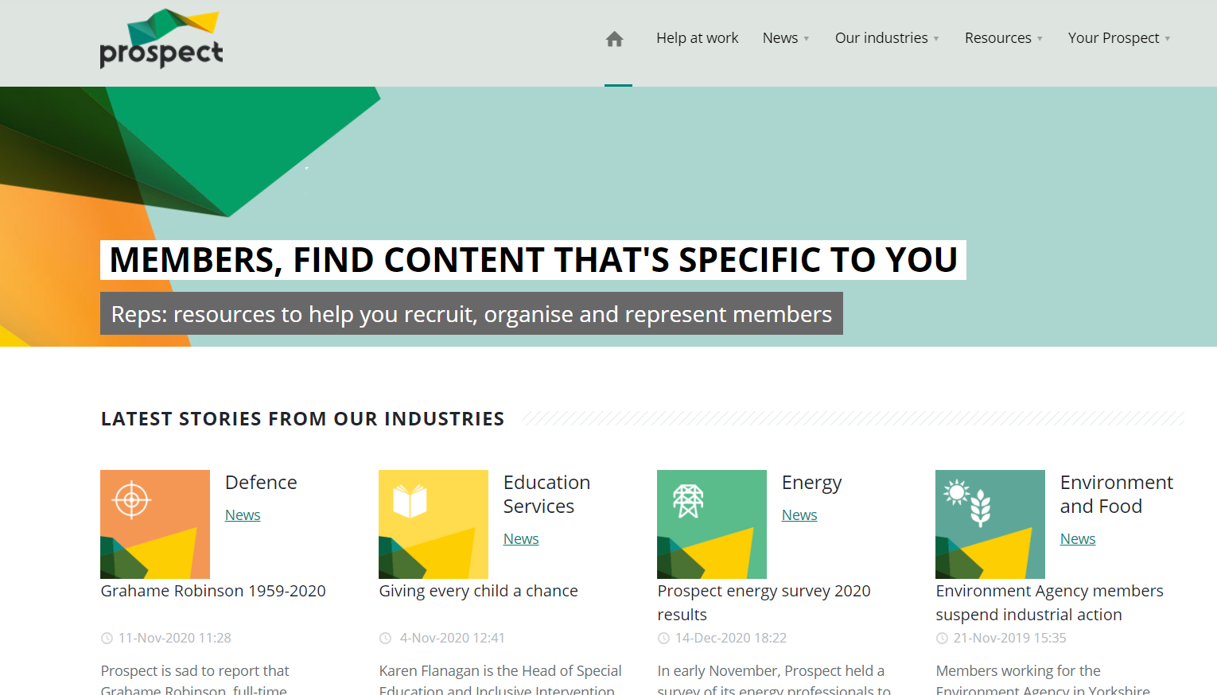
Prospect Websites: member site
eBranches
Sector and industry pages
Library of resources
Information on Networks
Member only content

Slide 20
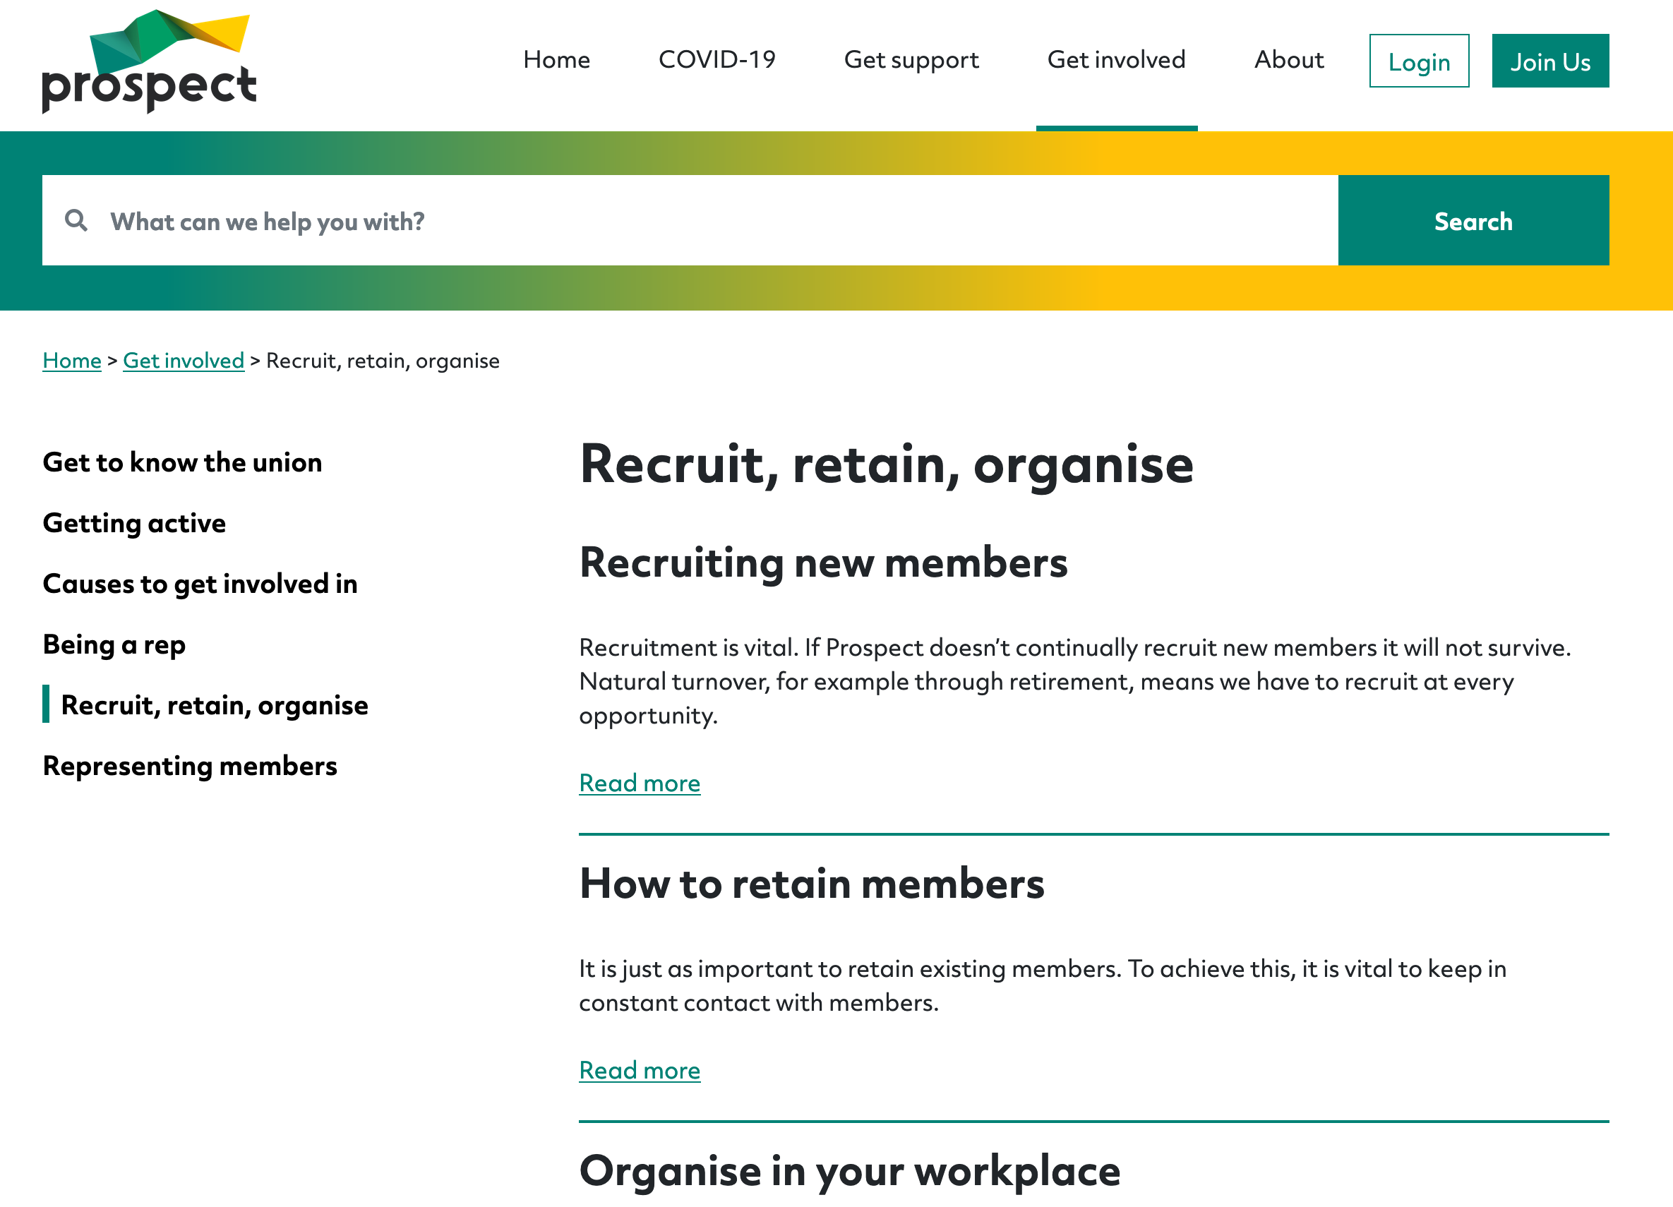
Prospect Websites: public site
Shop window
Clear design
Profiling multi-sector work
Information on Networks
Ambition page:
prospect.org.uk/about/ambition/
Notes:
Talk through ambition page

Slide 21
Your Websites:
Shop window
Clear design
Linked to Prospect/Bectu
Information on Networks
Ambition Page
Notes:
They reach the right audience at the right time
Can be understood by everyone.
Get people to take action
Accessible
User focused

Slide 22
Union Inductions
Get permission from employer
Aimed at new starters (no assumptions)
Short and snappy (20 mins absolute max)
Use your checklist
Who is who / where can you find them?
How to join (special offers if applicable)
Overview of main benefits/local wins.
Notes:
Mention 3 months free and Member recruit member.

Slide 23
Recap
Pros/Cons of your own website/Social media?
Consider GDPR….
What to do after an induction?
'Shadow tech'

Slide 24
What do effective communications look like:
They reach the right audience at the right time
Can be understood by everyone.
Get people to take action
Accessible
User focused

Slide 25
Social Media: best practice
Don’t say anything on social which you wouldn’t say in a workplace!
Sense check it if you’re not sure
Do be human, sardonic, fun and responsibly reactive. Social media never works if it’s too staid. Mix your scheduled posts in with some reactive ones too so you’re ‘on the story.’

Slide 26
4 steps
Step One – consistency
Step Two - engagement
Step Three – tone of voice
Step Four – go where your audience is….
Notes:
Reminder of four steps of Social media use.

Slide 27
Accessibility
Use a readable font size – at least 12pt
Use plain language – clear, concise and precise
Use good colour contrasts
Make your hyperlinks descriptive
Describe images and use transcripts for videos

Slide 28
Social Media
Reaching new audiences and potential members through regular posting
Scheduling i.e. Hootsuite or TweetDeck
Promote engagement - retweeting/reactive sharing tree
Different tone for different platforms
Go where your audience is

Slide 29
Surveys and getting your voice heard
Use surveys to get branch opinion
Survey potential members to find out issues you can organise around.
No longer than 10 mins to complete, 2 week roll-out.
Key is feeding back to participants

Slide 30
Creating newsletters
Digital newsletters allow you to be flexible – one big ticket item, or several small updates
A good newsletter has a human interest story and a call to action
Use bulkmailer for essential comms
Strong subject line, scheduling, when is it landing?

Slide 31
Activity E
Storywriting
Look over this passage and in pairs/small groups, create the following;
A social media post
A headline
A blog
Notes:
Breakout rooms
3x3’s if you can with the group.
5-8 mins for the activity
3-5mins to feedback (take 1 example from each group)

Slide 32
Recap
Communications and the rep role
Representing the union
Keep all communications professional
Use the templates and resources on the Prospect/Bectu website
Listen to your members
Notes:
No legislation for A comms rep – but use the rights to support the work you do.

Slide 33
Union influence & the comms rep role.
Recap on why ingredients are all required to make a successful union.
Virtuous Circle.

Slide 34
Next steps
What is your branch up to?
Health Check – follow up;
How well do you think your branch communications are working?
Are you reaching the right people?
What does success look like?

Slide 35
Plan of action
Ideas to produce a communication branch plan!
Notes:
Run through the plan and recap on everything we focussed on so reps know how to complete.
Talk about what happens now.

Slide 36
Any questions?

