Slide 1
Greenfield Site Training
Session 2
Jan.24
Notes:
Outcomes to be achieved:
This session is designed to find out:
How to go about recognition
How they can use the branch setup effectively
Support we can offer
Importance of mapping

Slide 2
A quick recap…
What is recognition and its benefits
Having joining conversations
Prospect’s code of practice
GDPR
Notes:
Just do a quick recap of what was covered in the last session. The key thing is to check they did the homework especially in relation to the code of practice

Slide 3
Code of practice for Prospect reps
Responsibilities
Act honestly, responsibly and with integrity.
Communicate respectfully and honestly.
Treat others with fairness, dignity, and respect.
Encourage the open expression of views at meetings but accept collective responsibility for all decisions and policies once finalised.
Not behave in ways that may cause physical or mental harm or distress to another person, such as verbal abuse, physical abuse, assault, bullying, or discrimination or harassment.
Notes:
This slide is just here and can be skipped if they did the homework and read this information. If not cover it now!
Tutor Note; In line with the latest agreed NEC guidance as of Dec 2021, new information of the code of practice all reps representing the union should adhere to.

Slide 4
Process of recognition
Notes:
Outcomes to be achieved:
This is the formal recognition procedure. If a voluntary agreement is being looked for there are many similarities, however we never share membership figures/names with management. The process is the same up to the “admissibility tests” slide. Instead of going to the CAC we write to management and seek to reach an agreement together. It is still as legally binding as the CAC process if an agreement is reached.

Slide 5
Recognition – how to….
The Key Stages
Preliminary issues
The bargaining unit
Request to the employer
Admissibility tests
Application form
Recognition Agreement
Notes:
INTRODUCTION
The statutory trade union recognition procedure has been in place now for almost twenty years. Over that time Prospect and BECTU have had several successful applications, but of course it is always best to gain recognition voluntarily.
The legislation is in Schedule A1 of the Trade Union and Labour Relations (Consolidation) Act 1992. The Schedule is complex and long, it covers recognition and de-recognition.
There are also the Information and Consultation of Employees Regulations (ICE), which provide for much more limited consultation in areas where we are unable to secure recognition. These Regulations provide for a limited amount of information and consultation to take place regarding key matters affecting the employees (such as redundancy, redeployment and restructuring) and will apply whether or not the employer recognises a union.
The Central Arbitration Committee (CAC) is the body that makes decisions on recognition applications. The CAC produces very clear and helpful guidance on the processes, along with copies of the application forms, on its web site at www.cac.gov.uk. This guidance is essential to consider before making an application. The site also lists all current applications and past decisions.

Slide 6
Preliminary issues
Build membership
Pay hours and holidays
21 or more workers
No existing union recognition
Competing applications and joint applications
Bar on further applications for 3 years
Notes:
PRELIMINARY ISSUES
The first thing is to do the ground work in terms of recruitment of members and organising to ensure we have an effective base for pursuing a claim for recognition with the employer. In order to gain recognition the union needs to be able to show that the majority of staff want recognition and key to this is building membership density.
Another key factor at the very beginning of the process is to be clear who will be directly involved in the application for the union, usually the negotiator, organiser and EA/SEA. Many of the actions required by the CAC require a very fast turnaround, so we need to ensure that we will be in a position to respond quickly to any correspondence or actions required.
While the CAC procedure is aimed at being practical and straightforward, there are several legal pitfalls and a large body of precedent, so we recommend you always work with your legal officer.
In Prospect all cases where we expect to make a statutory application must be raised with a member of the SMT at the start of the process.
Pay Hours and holidays
The legislation only provides statutory recognition in respect of bargaining over pay hours and holidays, whereas most Prospect agreements cover a much wider range of issues, including all terms and conditions, equality, pensions and learning.
However, even where using the statutory route to recognition, we would still aim for the usual broad coverage of the final agreement.
21 or more workers
An application for recognition can only be made under the statutory process where there are 21 or more workers employed by the company or organisation. In calculating the threshold, each worker counts regardless of whether they work full time or part time.
The legislation applies to the broader definition of ‘worker’ rather than employee, so atypical workers such as consultants, freelances, and homeworkers will count towards the threshold.
No existing union recognition
An application can only be made if the employer does not already recognise a union for this group of workers (whether or not the union is independent). This avoids inter union disputes, but can also be abused by an employer who decides to recognise a ‘sweetheart’ union to block a genuine attempt. In these circumstances the only thing to do would be to attempt to de-recognise the other organisation, using the process in the legislation, and then seek recognition.
Competing applications and joint applications
The legislation excludes claims where there is a competing application for recognition covering workers in the same (or an overlapping) bargaining unit, if both unions have more than 10% membership. If two unions make a claim, but only one has 10% membership then that union’s application can proceed. However if both unions have 10% membership then neither claim can proceed. It will be important to ensure that there are positive inter-union relations to circumvent any difficulties.
There is however the option of a joint application, so that two unions could apply for the same bargaining unit on the basis of representing different workers. They would need to demonstrate that they would be able to work together in the future should recognition be granted. In practice this is unlikely to be a problem.
Bar on further applications for 3 years
If an application for recognition gets through the initial admissibility tests for the CAC (see below), then no further application for that bargaining unit can be made for a further three years. This does mean that we would need to be sure of the likely success of the application before proceeding, because if a ballot for recognition is lost it will be a long time before we (or any other union) could apply again.

Slide 7
The Bargaining Unit
Determine the bargaining unit that we are seeking recognition for. This could be the whole of the company or organisation, or it could be limited to certain groups of workers or locations.
During this the CAC will need to rule on whether the union’s chosen unit is ‘compatible with effective management’. This must take account of the following factors:
• The views of the employer and union
• Existing national and local bargaining arrangements
• The desirability of avoiding small fragmented units
• Characteristics of workers in the proposed bargaining unit and any other relevant employees
• The location of the workers.

Slide 8
Request to Employer
Be in writing
Identify the union
Identify the proposed Bargaining Unit
State it is made under Schedule A1 of TULR(C)A 1992.
The CAC guide recommends that the union has proof of sending.
The employer is required to respond to the union’s request within 10 working days. The response must either state they accept or reject the application, or the employer can propose that there are negotiations through ACAS.
Notes:
Where the parties agree to ACAS involvement an additional 20 days are allowed for this to happen before a final response must be made by the employer.
If the employer rejects the union’s application there is no role for ACAS, and the union should make the formal application to the CAC.
If the employer proposes to involve ACAS but the union rejects this, or does not respond to the proposal within 10 days, the union will not be able to proceed with an application to the CAC.

Slide 9
Admissibility tests
The CAC must be satisfied at this first stage that there is;
At least 10% union membership within the bargaining unit and
evidence that the majority of workers are likely to support recognition.
demonstrating that a majority of workers would be likely to support union recognition, can be more difficult. In Prospect’s experience, such evidence can include online surveys
. Survey question could be something like:
“Would you like Prospect to be recognised by your employer to negotiate on your pay, working hours, and holidays?”
The research department can assist with running a survey or petition, and you may want to check the questions with the legal team.
Notes:
ADMISSIBILITY TESTS
The key factor for the CAC, in order to allow the application to be accepted and proceed to consideration of a ballot, is that the union can demonstrate sufficient support for recognition from the workers
If the employer rejects the union’s application or fails to respond within the time limits the next stage is to make a formal application to the CAC. The CAC then apply a number of tests to see whether the application is admissible under the terms of the legislation.
The CAC can only let an application proceed if they determine all following tests of admissibility have been met:
• The application has been made on the proper form
• The application has been received by the employer
• The union has a certificate of independence from the Certification Officer
• The employer employs at least 21 workers overall
• There is no competing application from another union
• There is not an existing recognition agreement for this bargaining unit
• There are at least 10% of the workers already in union membership
• The majority of workers are likely to favour recognition
• Where it is a joint application, that the unions can show they will co-operate
• There has not been a previous application for the same bargaining unit in the last three years

Slide 10
The Application form
The application form to the CAC is on their website and the form must be used. The form must provide:
The number within the proposed bargaining unit in union membership
Evidence that the majority of workers are likely to support recognition
Details of the proposed bargaining unit.
There may be some reviewing of the bargaining unit, and a ballot may be called
IT IS ONLY YOUR FULL TIME OFFICER WHO SHOULD COMPELTE THIS FORM
Notes:
The application will be copied to the employer, with supporting documents. But you do not need to disclose any names of members (and are best not to). The names will need to be disclosed to the CAC for them to check the application later on, but this will be treated in confidence by the CAC and only the numbers will be disclosed to the employer.
The form asks for the number in union membership in the bargaining unit. You should provide the number and could provide an extract from membership data with the names and personal details redacted.
If a petition or survey is done, the full details should not be included with the application form (so that names are not disclosed at this stage). But you should include in the application the numbers we believe would support recognition and an explanation of the method of how we have established this. If there was a survey you could provide the report of the survey, without names or contact details.
The CAC will allocate a case worker, who will be responsible for all the administrative stages of the application. The CAC caseworker will need to have the full details of membership records and any surveys or petitions, including names, in order to check the details against the employer’s staff records. But this should not be included with the application form.
The Employer will be asked to respond to the union’s claim, and this response will be sent to the union.
The CAC may ask for more information from both parties before determining whether the admissibility tests have been satisfied, and they could decide to have a hearing on any point. They will then make a formal determination.
As mentioned above, once the application has been accepted at this initial stage by the CAC the union is barred from applying for recognition with the same (or substantially similar) bargaining unit for three years.
The application will be coped to the employer, with supporting documents. But you do not need to disclose any names of members (and are best not to). The names will need to be disclosed to the CAC for them to check the application later on, but this will be treated in confidence by the CAC and only the numbers will be disclosed to the employer.
The form asks for the number in union membership in the bargaining unit. You should provide the number and could provide an extract from membership data with the names and personal details redacted.
If a petition or survey is done, the full details should not be included with the application form (so that names are not disclosed at this stage). But you should include in the application the numbers we believe would support recognition and an explanation of the method of how we have established this. If there was a survey you could provide the report of the survey, without names or contact details.
The CAC will allocate a case worker, who will be responsible for all the administrative stages of the application. The CAC caseworker will need to have the full details of membership records and any surveys or petitions, including names, in order to check the details against the employer’s staff records. But this should not be included with the application form.
The Employer will be asked to respond to the union’s claim, and this response will be sent to the union.
The CAC may ask for more information from both parties before determining whether the admissibility tests have been satisfied, and they could decide to have a hearing on any point. They will then make a formal determination.
As mentioned above, once the application has been accepted at this initial stage by the CAC the union is barred from applying for recognition with the same (or substantially similar) bargaining unit for three years.
REVIEWING THE BARGAINING UNIT
Once the CAC has accepted there is an admissible application by the union, they will notify the union and employer. It is possible for the parties to reach a ‘semi-voluntary’ agreement for recognition at this stage. If they do that, it will be an end to the CAC process.
The CAC at this stage will determine if the proposed Bargaining Unit is appropriate, taking account of the factors above and may require further information from both sides. There may also be a CAC hearing to decide this point.
If the CAC do not accept the union’s proposed bargaining unit, they can determine a different unit and the application can proceed on that basis. For example the CAC may add in a further group of workers.
If the Bargaining Unit is different to the union’s original proposal then the CAC must reconsider the admissibility tests on the basis of the new bargaining unit.
BALLOT
Depending on the level of membership a ballot may be called and run by the CAC to ascertain that the workforce does want a Trade Union to represent them collectively. This ballot will go to all impacted employees, not just union members. If we have above 50% membership a ballot is not usually called for.

Slide 11
Recognition Agreement
A formal recognition agreement provides a framework for industrial relations within an organisation.
It sets out the rules and procedures to be used by the union and the employer in carrying out consultation, collective bargaining and representation.
It is in the interests of both parties to have a clear and comprehensive recognition agreement.
A good agreement will contribute to:
Positive employment relations between unions and management;
High levels of employee participation; and
Effective procedures when dealing with problems and organisational change.

Slide 12
The Purpose of the agreement
Most recognition agreements begin with a clause outlining the goals the parties wish to achieve which sets the tone for the rest of the document.
It will often include a commitment to:
Co-operate in achieving positive industrial relations;
Use a joint approach to training in industrial relations procedures
Engage in effective communications with employees;
Achieve greater participation and involvement of all members of staff
Work towards a high quality service.

Slide 13
Your membership and set-up
Notes:
Outcomes to be achieved:

Slide 14
Your branch membership
As people join up they will be placed within a branch. They may be put into a section, or you may have a designated branch.
ACTION – Check your set-up as this will impact your eSite access
Notes:
Prospect branches come in all shapes and sizes. They evolve to fit the needs of the members. Most are designed to match the organisation structure of the employer.
Regional branches – too small to form a branch (under 21 members) or there is no recognition from the employer.
TU act 2015 for a ballot of members to be legal it has to have all of the members who are affected by the outcome balloted and this can be called into question by the employer
Basic principle of this section is that delegates start to understand the structure and democratic structure of union
Running a union democratically can be difficult, but it’s worth it
Takes balance between pure-representation, and leadership
About giving members a say…
…and making sure they KNOW they have a say, and how.
Gives them ownership of THEIR union
If we can unite members behind an issue raised by them, chosen by them, that’s important to them, it gives us the foundation for VISIBLE union activity
One of the main roles of the rep is guiding new members into the right branch

Slide 15
What happens when a new member joins Prospect?
A new member is put into the appropriate branch.
This is decided from the following information:
their job or role
who they work for
their work location
Notes:
Learn how a branch is determined and a new member is put in a branch
Where they work to be relevant for their workplace
Who they work for so pay and conditions can be improved.
What they do, so working conditions can be compared with others who do the same role.
If they are aware of people joining up and they are not appearing on the correct list can they let us know asap. It may be they have been incorrectly placed on the system.

Slide 16
Prospect eSite
Prospect gives branches a way of communicating with their members which reduces the chance of a data breach when sending emails. This is done via our free eSite system
Branch officers (Secretary/assistant, chair/vice chair, membership and recruitment secretary/organiser automatically get admin rights to look after their eSite, as does our new communications rep role)
All branches have a ‘starter’ eBranch which gives their branch officers access to online membership lists. The same applies at section level.
The eSite allows you to track your membership, as well as offering a bulk mailing ability
Notes:
Most GDPR compliant way of contact reps via bulk mail, with updated minutes, newsletters etc….
Go over the functionality of the ebranch. (Communications role access rights for this area of work)

Slide 17
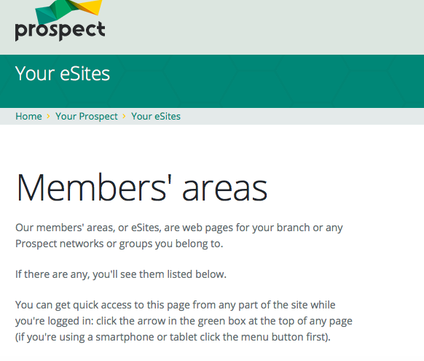
eBranch
If you want to have your eSite turned on speak with your Officer or Organiser and they can arrange for this to happen.
Notes:
Outcome to be achieved: learn The best way to comply is to communicate with members is through the website
Check that the reps are aware of the ebranch and the members area. Take them through the eSite if at all possible to show how it works.

Slide 18
Support for you
Research
Negotiation officer
Education
Networks
MCC
Organiser
Legal
Comms
Branch
As part of your action plan find out who is your branch negotiation officer and organiser.
Notes:
Outcome to be achieved:
Understand what support is available
If you are just teaching one branch you may be able to name the officers, but it is written in their action plan to find out.

Slide 19
Growing the unions influence
Notes:
Outcomes to be achieved:

Slide 20
Ingredients
Membership density
Engaged members
Visible Profile
Constructive Dialogue
Representative membership
Representatives
Equality & Diversity
Notes:
Outcome to be achieved: learn what different roles there are in the branch
Density – proportion of members to help campaign./add their voice
Engaged members – keeping information relevant and specific, timely and useful.
Visible profile – is the union visible in the workplace, if you started a job tomorrow, would you know how to join the union?
Constructive dialogue – do you listen to members? Do you have opportunities to discuss issues? Is it worthwhile conversation?
Representative membership – Does every member in your branch have a say – or a rep to speak on their behalf. If you have a large percentage of under 35’s – do you/have you elected a young members rep? To ensure the proportion of the memberships’ voice is heard.
Representatives – Key role in the communications between the employer and the members and the union and it’s members. Supporting/advisory roles.
Equality and Diversity. – Encourage reps that this should be paramount in their thinking in line with union values. A key benefit to demonstrate to members – improving conditions for all.

Slide 21
The virtuous circle
Growing Membership
Members set and support union’s negotiating priorities
Negotiations deliver results
Encourages others to join
Notes:
Outcome to be achieved: learn how you need all the ingredients to make a strong branch
When the virtuous circle is working effectively members can see the benefit of being part of the union and they take that message with them – whatever company they work for in the future.
Effective local organisation – meaning reps like you – stands at the heart of Prospect’s ability to keep the virtuous circle going. Local union reps…
are the union’s eyes and ears, picking up issues that matter to members and can be resolved by negotiation.
are the union’s voice in the workplace, getting members involved in new campaigns and keeping them informed about on-going negotiations.
give the union a positive profile – visible on notice boards, identified with important issues.
grow the union by talking about joining to colleagues who are not yet in Prospect
keep members in touch with the wider union, eg by organising meetings and events with visiting speakers from beyond the branch.
A really important task for everyone involved in Prospect’s activities is to feed members’ views, queries, concerns and ideas back to Prospect – keeping the union in touch with members.

Slide 22
Building a stronger union in your workplace
Notes:
Outcomes to be achieved:

Slide 23
Download the activity form ttps://library.prospect.org.uk/download/2024/00583
Notes:
Outcomes to be achieved:

Slide 24

Activity:
Map your work area
Working in a big group in the sample department information
Complete a map of the department in the following ways:
Give every staff member a score of 1 to 5 as to how pro union they are
Draw a map of this workplace showing the three sections and give a summary of members vs non-members.
Notes:
SHEET FOR ACTIVITY IS ON THE activists resource page
Do this activity as big group face to face
Outcome to be achieved:
How mapping can help your recruitment efforts, identifying key issues and understanding your membership. Be mindful of GDPR when listing staff – this can be useful when identifying areas of low density but also help identify issues faced in areas of the workplace.

Slide 25
Next steps for you
Notes:
Outcomes to be achieved:

Slide 26
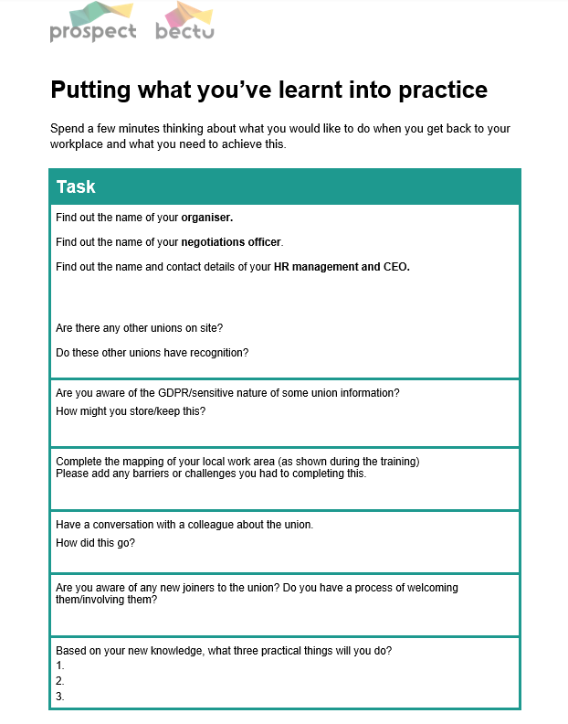
Notes:
This is the action plan that needs to be shared with the Organiser and Officer.
On the resource page it’s entitled ‘putting what you’ve learnt into practice. ‘

Slide 27
Back in the workplace
Homework
Complete the Action Plan and share this with your Organiser and Officer
Complete the mapping template
All of this information can be found on the
Notes:
At the end of the session run the polls.
Hopefully set a date for the final session.

Slide 28
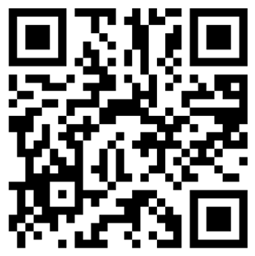
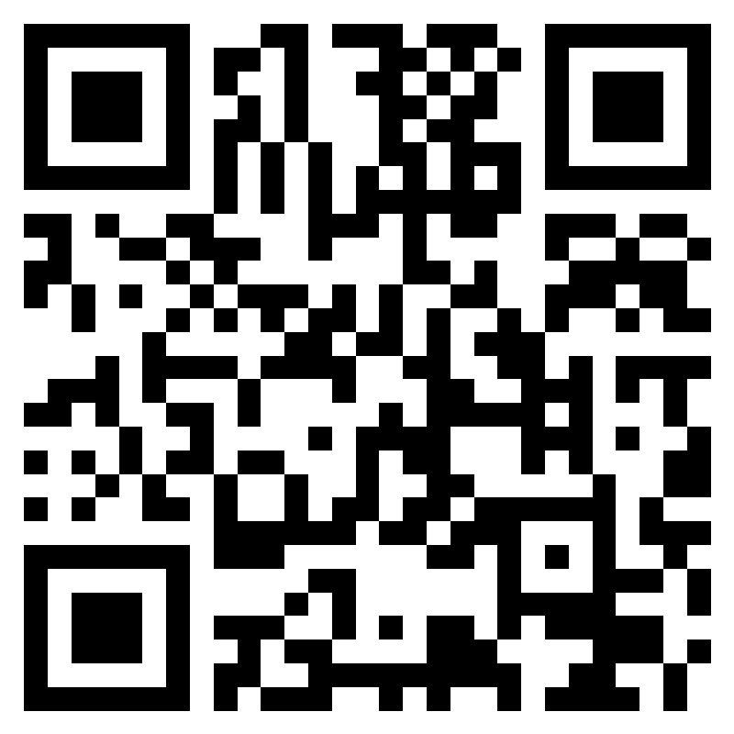
Evaluation & EDI
https://forms.office.com/e/5FCnzqRaMj
https://forms.office.com/e/
ZQmRFJYa6i?origin=lprLink
Notes:
On teams where no polls are set up – use these links/QR codes for the evaluations & EDI
If reps click on the link and then they’ll get the option to open the link and this will take them through to the form.

